Slide 1


Distributed Computing using Jupyter Notebooks with Spark
Data Science Applications

Slide 2


About
Jason Yang
Data Scientist @ InMarket
a consumer intelligence and real-time activation mobile advertising company
Presentation: github.com/jasonwithcoffee/jupytercon2020-jupyter-spark
linkedin.com/in/jasonwithcoffee

Slide 3
Overview
Background
Why
Scaling Out
2020 is a Great Year for Jupyter + Spark
How
How to spin up a Spark cluster with Jupyter Notebook on Google Cloud
Using 16-node cluster with 1TB+ RAM for LDA topic modeling
Visualizing Spark results in Jupyter Notebook

Slide 4
Background
Amount of data is growing exponentially
Jupyter + Spark
Recent developments in the cloud offerings (AWS, GCP, Azure) makes management simple
Source: International Telecommunications Union

Slide 5
Why
Scaling Out
2020 is a Great Year for Jupyter + Spark

Slide 6



Scaling Out
Local
CPU: 4 Cores
RAM: 16GB
Cloud Compute
CPU: 32 Cores
RAM: 256GB
(Cloud Compute)*n
CPU: 32*n Cores
RAM: 256*n GB

Slide 7
2020 for Jupyter + Spark
Apache Spark 3.0 Release
2018 Cloud Providers Images for Jupyter, Zeppelin, Spark

Slide 8
How
How to spin up a Spark cluster with Jupyter Notebook on Google Cloud
Using 16-node cluster with 1TB+ RAM for LDA topic modeling
Visualizing Spark results in Jupyter Notebook

Slide 9
Jupyter + Spark on GCP
Dataproc: Google Cloud service for running Apache Spark and Hadoop clusters

Slide 10
Jupyter + Spark on GCP
Configure machine type

Slide 11
Jupyter + Spark on GCP
Enable Component Gateway
Provide Cloud Storage Bucket
Set Image to 1.5+
Select Optional Components
Allow API access

Slide 12
Jupyter + Spark on GCP
Select Anaconda and Jupyter Notebook

Slide 13
Jupyter + Spark on GCP
Navigate to Web Interfaces to access Jupyter

Slide 14
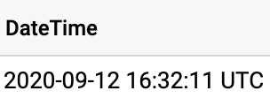
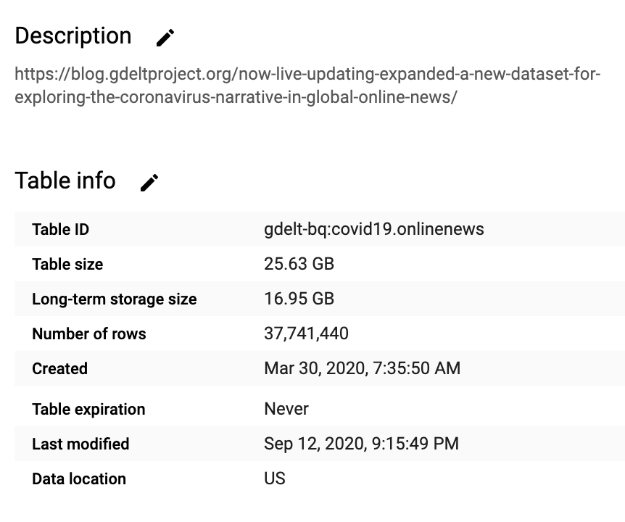

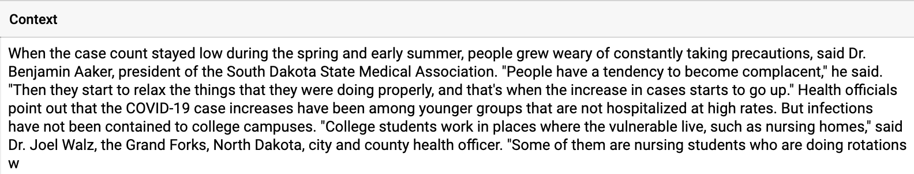
16-Node Cluster DEMO
LDA Topic Modeling on COVID-19 News

Slide 15
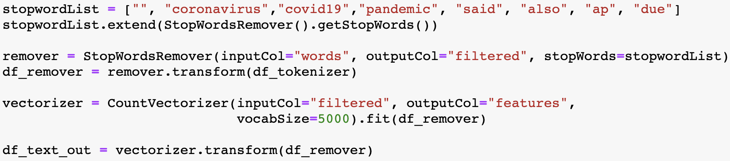
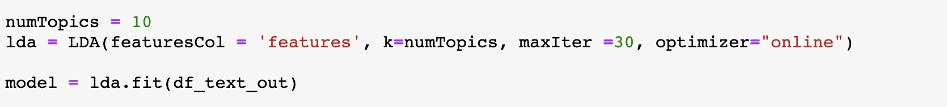
16-Node Cluster DEMO
Data Prep
Tokenize
Remove Stopwords
Vectorize
LDA Configuration
# Topics = 10
maxIter = 30

Slide 16
16-Node Cluster DEMO

Slide 17
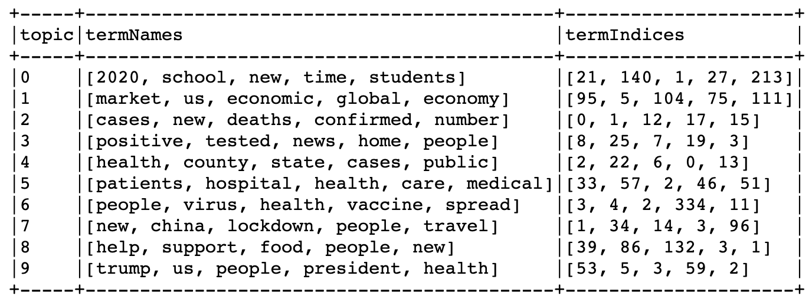
16-Node Cluster DEMO
LDA Topics

Slide 18
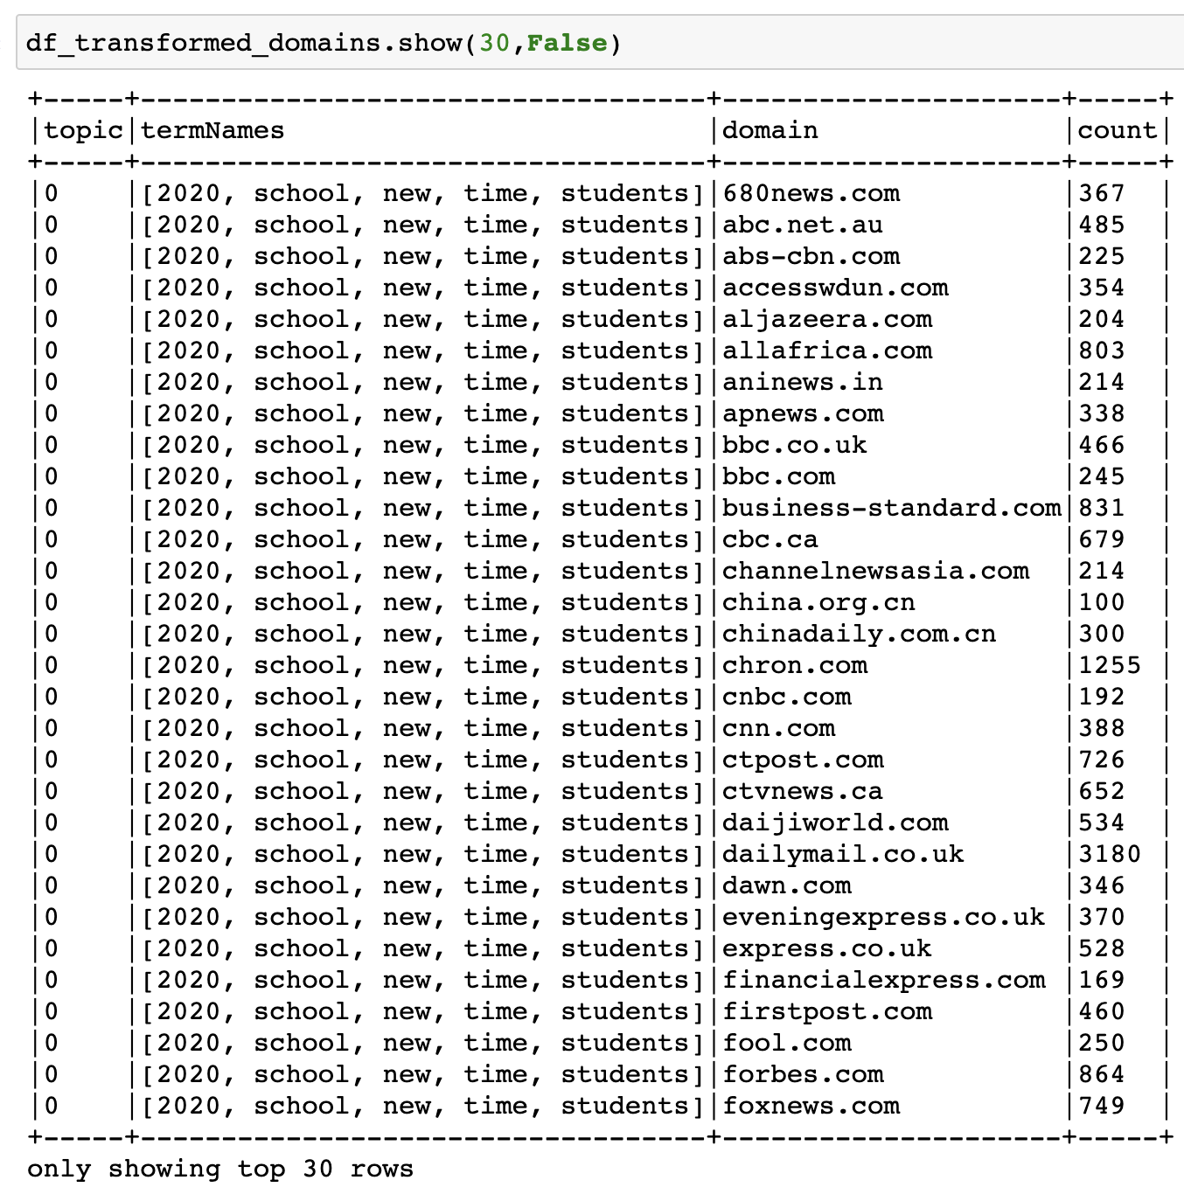
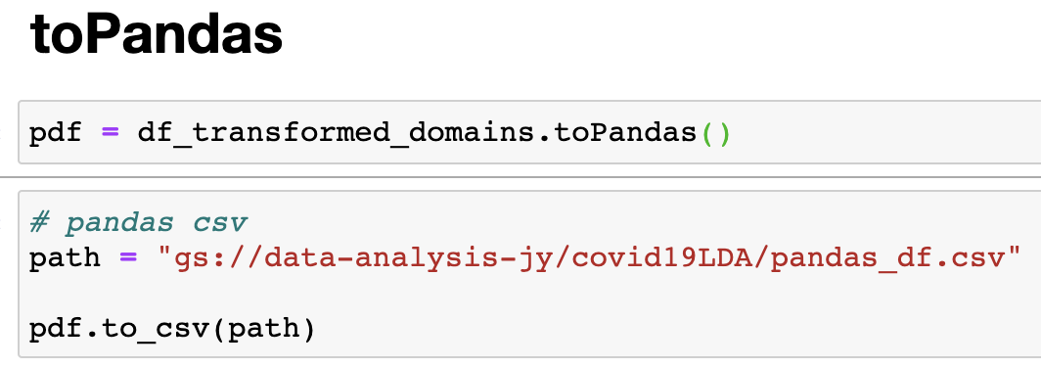
Visualizing in Jupyter Notebook
Analyze our results in the notebook using:
Pandas
Seaborn
Matplotlib
Scikit-Learn

Slide 19
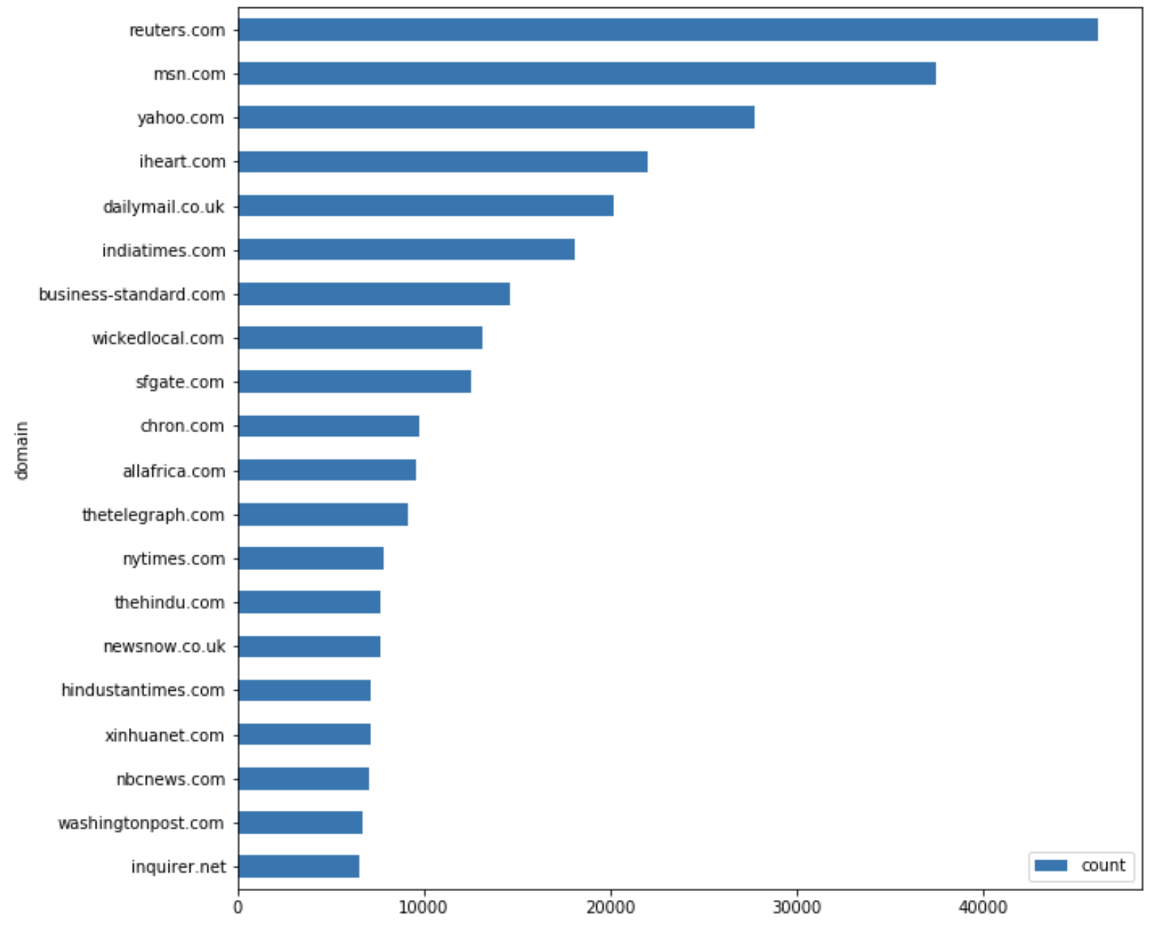
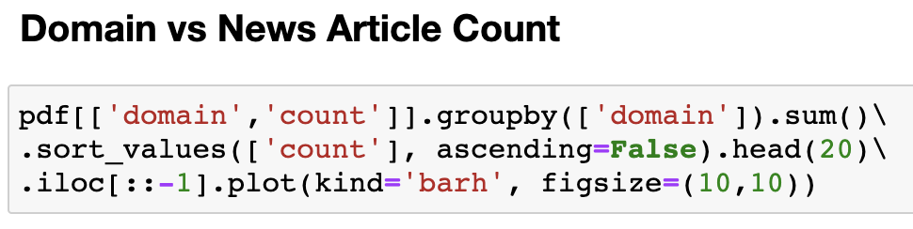
Visualizing in Jupyter Notebook
How many COVID-19 news articles per domain?

Slide 20
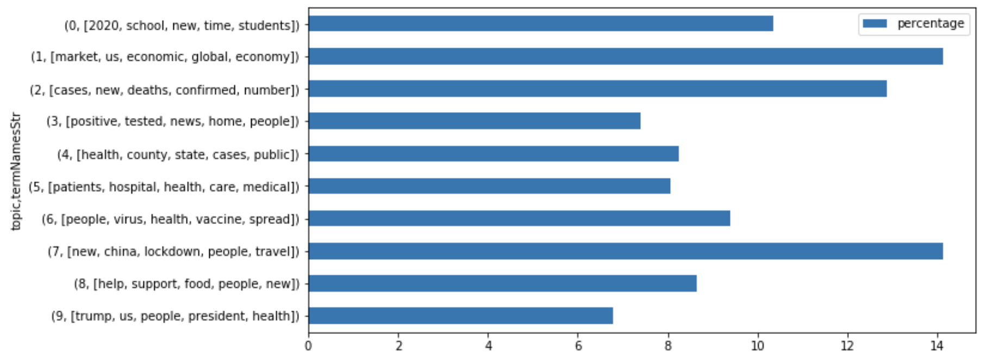
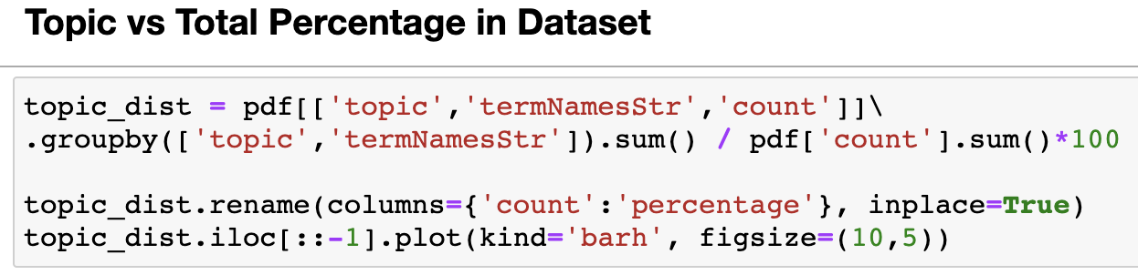
Visualizing in Jupyter Notebook
What is the distribution of COVID-19 news articles by topic?

Slide 21
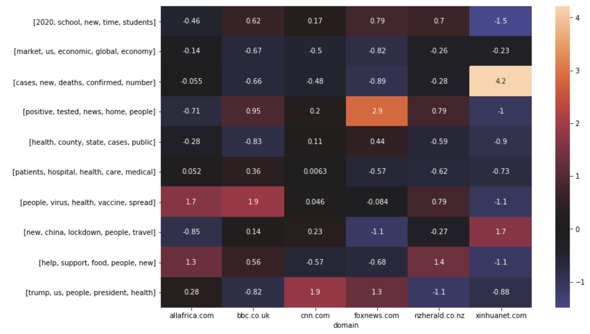
Visualizing in Jupyter Notebook
Topic Standard Deviation by Domains

Slide 22
Visualizing in Jupyter Notebook
Topic Standard Deviation by Domains

Slide 23
Visualizing in Jupyter Notebook
Topic Standard Deviation by Domains

Slide 24
Visualizing in Jupyter Notebook
Topic Standard Deviation by Domains

Slide 25
Visualizing in Jupyter Notebook
Topic Standard Deviation by Domains

Slide 26
In Conclusion
Jupyter + Spark is a powerful combination in your data science toolkit to handle big data.
In this talk, we explored running Jupyter on a cluster of machines in the cloud.
Using PySpark, we constructed a pipeline for LDA Topic Modeling on 2.8 million news articles on COVID-19.

Slide 27
About
Jason Yang
Data Scientist @ InMarket
a consumer intelligence and real-time activation mobile advertising company
Presentation: github.com/jasonwithcoffee/jupytercon2020-jupyter-spark
linkedin.com/in/jasonwithcoffee

Slide 28
Thank you

